Slide 1


Scanner
© LPU :: CSE310 Programming in JAVA ::
Notes:
<number>

Slide 2
Scanner Class
A simple text scanner which can parse primitive types and strings using
A Scanner breaks its input into tokens using a delimiter pattern, which by default matches whitespace
Resulting tokens may then be converted into values of different types using the various next methods
E.g.
Scanner sc = new Scanner(System.in);
int i = sc.nextInt();
Scanner sc = new Scanner(new File("myNumbers"));
while (sc.hasNextLong()) {
long aLong = sc.nextLong();
}
© LPU :: CSE310 Programming in JAVA ::
Notes:
<number>

Slide 3
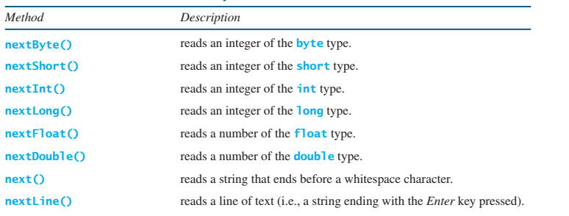
Scanner Class
© LPU :: CSE310 Programming in JAVA ::
Notes:
<number>

